Slide 1
Intrusion Detection Systems
NSL - KDD Dataset
Mentored by: Mayank Agrawal Sir

Slide 2
Introduction
Have you ever wondered how your computer or network manages to stay malware-free?
Intrusion Detection Systems (IDS)
NSL-KDD Dataset

Slide 3

Intrusion Detection Systems

Slide 4
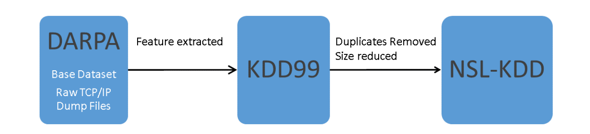
NSL-KDD DataSet

Slide 5
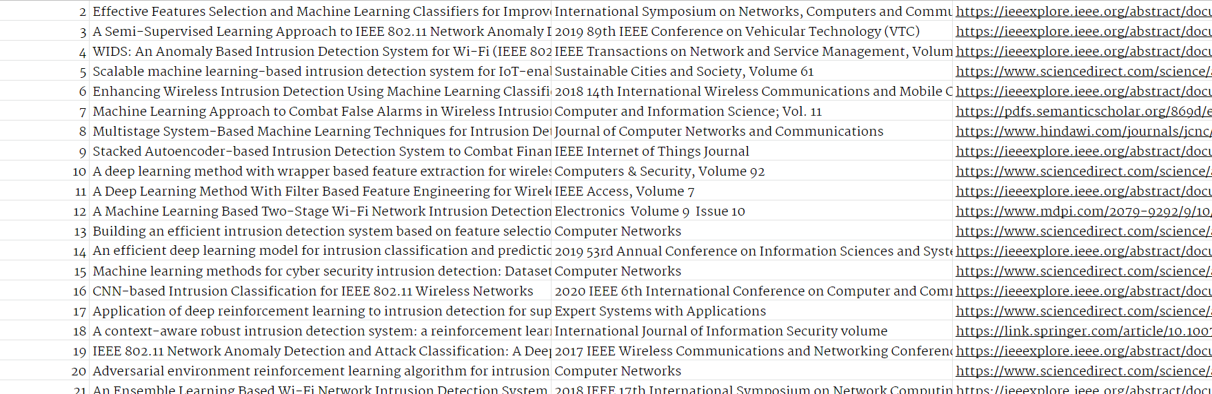
Process
Research & Analysis

Slide 6
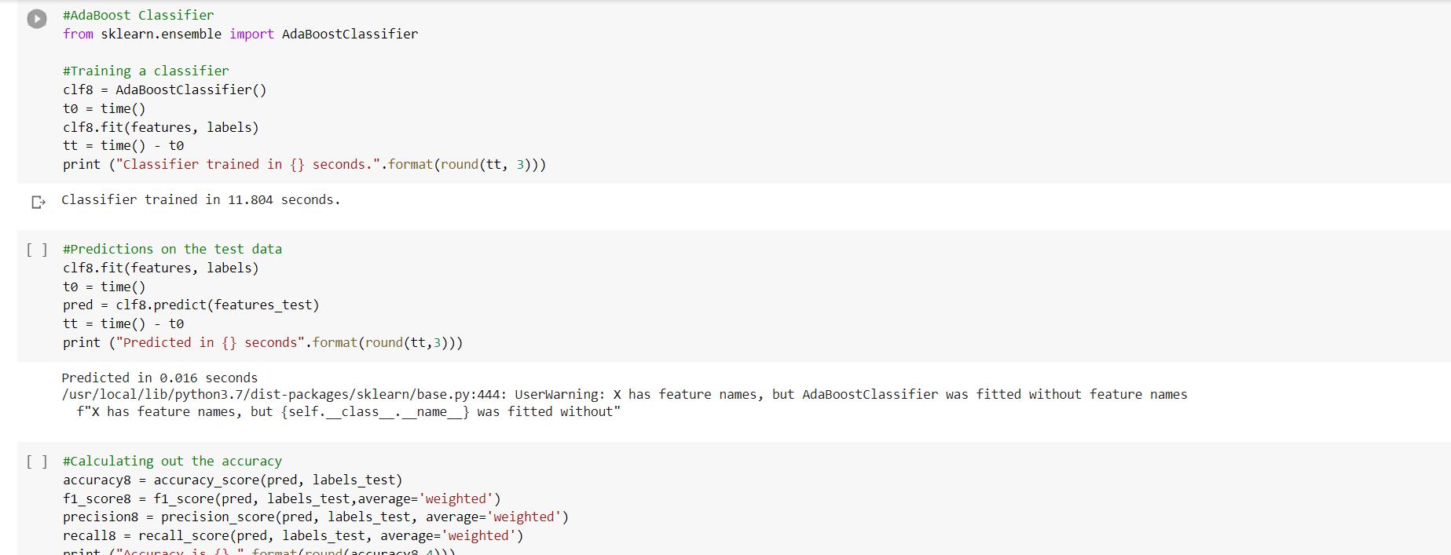
Process
2. Implementation of Algorithms

Slide 7
Components
Classifiers Used
Metrics
Tools
KNN Classifier
SVC Classifier
Logistic Classifier
MLP Classifier
SGD Classifier
Gaussian Classifier
Decision Tree Classifier
AdaBoost Classifier
Random Forest Classifier
CNN
Accuracy
F1 - Score
Recall
Precision
Google Collab
Jupyter Notebook
Google Spreadsheet

Slide 8

Results

Slide 9
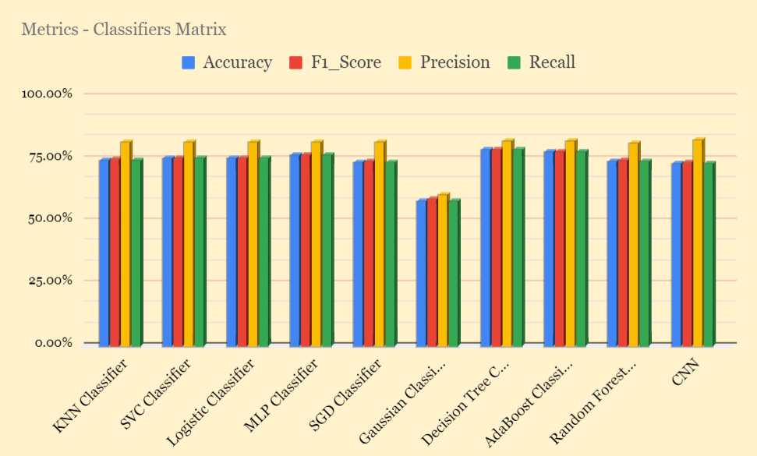

Slide 10
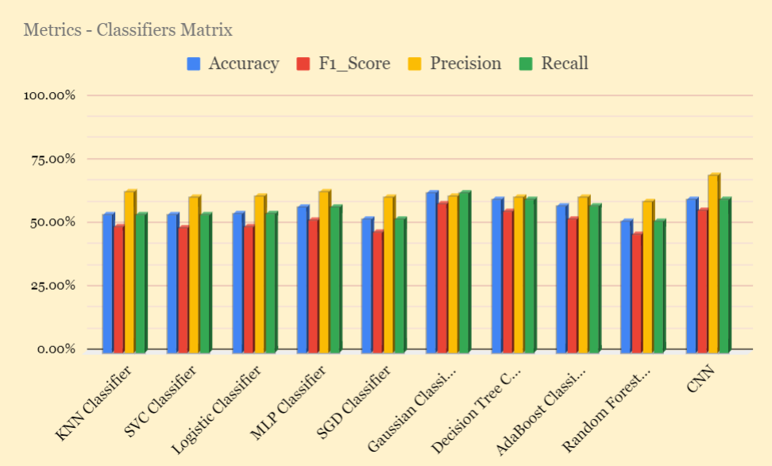

Slide 11
What’s the next step in this?
Plans.

Slide 12
Name: Rohit Kumar
Roll: 2001CS55
Professor: Mayank Agarwal Sir
Thank You!
Questions?

